Slide 1
A Proxy Re-Encryption Approach to Secure Data Sharing in the Internet of Things Based on Blockchain
PRESENTED BY :
B Chaitanya 20AP1A0507
M Vaishnavi 20AP1A0534
K Prasanna 20AP1A0528
K Sai durga prasad 20AP1A0530 GUIDED BY:
Mr. G.S. V. R. ABHISHEK
Assistant Professor.

Slide 2
CONTENT
ABSTRACT
INTRODUCTION
EXISITING SYSTEM
LITERATURE SURVEY
PROPOSED SYSTEM
SOFTWARE REQUIREMENTS SPECIFICATIONS
ALGORITHMS
UML DIAGRAMS
SCREENSHOTS
CONCLUSION
REFERENCES

Slide 3
ABSTRACT
Internet of Things has seen data sharing as one of its most useful applications in cloud computing. propose a proxy re-encryption approach to secure data sharing in cloud environments. Data owners can outsource their encrypted data to the cloud using identity-based encryption, while proxy re-encryption construction will grant legitimate users access to the data. With the Internet of Things devices being resource-constrained, an edge device acts as a proxy server to handle intensive computations. Also, we make use of the features of information-eccentric networking to deliver cached content in the proxy effectively, thus improving the quality of service and making good use of the network bandwidth.

Slide 4
INTRODUCTION
Proxy Re-encryption: Legitimate users are granted access to the encrypted data through a proxy re-encryption construction. This allows the proxy server to transform the encrypted data from the data owner's key to the user's key without seeing the decrypted data..
Information-Centric Networking (ICN): ICN features are utilized to deliver cached content effectively in the proxy, improving quality of service and optimizing network bandwidth usage.
The system model is based on blockchain, a disruptive technology that enables decentralization in data sharing.

Slide 5
EXISTING SYSTEM
Attribute-Based Encryption (ABE): to enhance security in IoT data sharing. However, these schemes face challenges like heavy computation and inefficiency in managing complex data scenarios. Some schemes also rely on stronger trust assumptions or third-party involvement, which may not be suitable for all IoT applications.
DISADVANTAGES
Attribute Based Encryption Method which leads less security on outsourced data.
Attribute Based Encryption is centralization technology.

Slide 6
LITERATURE SURVEY
1)Blockchain-Based Access Control and Data Sharing:
Author : Fan et
Blockchain can serve as an automatic access control manager by storing only data addresses instead of actual data. peer-to-peer (P2P) data sharing.
DRAWBACK
In blockchain storing only actual data.
Using public blockchains for storing access policies may lead to access policy leakage

Slide 7
2)Access Control Schemes for ICN
Author: Ateniese
Proxy re-encryption, access control involves the data owner encrypting the content and defining an access policy that determines who can access the encrypted data.
DRAWBACK
Single point of failure if the proxy server fails.
Cached content in plaintext is vulnerable to attacks. key generation and distribution are not suitable for IoT

Slide 8
PROPOSED SYSTEM
Improved Data Delivery: Edge devices improve data delivery by acting as proxy nodes that re-encrypt cached data, ensuring efficient and secure data transmission.
High Performance Networking: With more computational power than IoT devices, edge devices enhance network performance and effectively utilize network bandwidth.
ADVANTAGE
The proposed system is secure against man-in-the-middle (MITM) attacks
System is secure and safe.

Slide 9
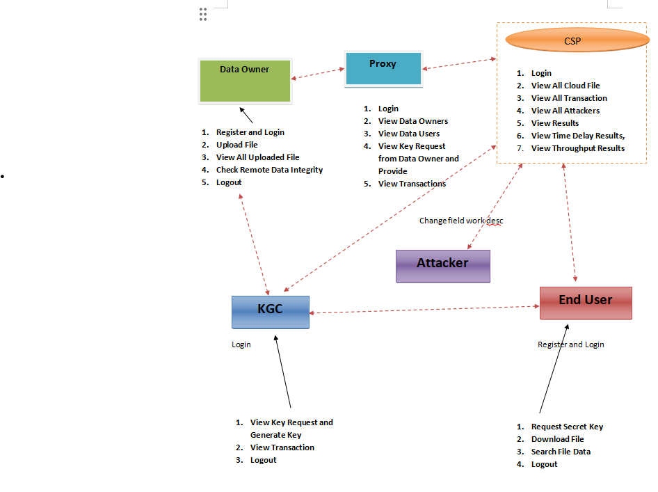
System Architecture

Slide 10
SOFTWARE REQUIREMENTS:
Operating System - Windows 10
Coding Language - Java/J2EE
Front End - Html5, Css3, Javascript
Back End - MySQL

Slide 11
HARDWARE REQUIREMENTS :
Processor - Intel i3 11th Generation
Random Access Memory - 8GB
Hard Disk - 512gb SSD
Server - Xampp

Slide 12
ALGORITHMS
SHA( Secured Hash Algorithms)
Advanced Encryption Standard (AES)
RSA Algorithm

Slide 13
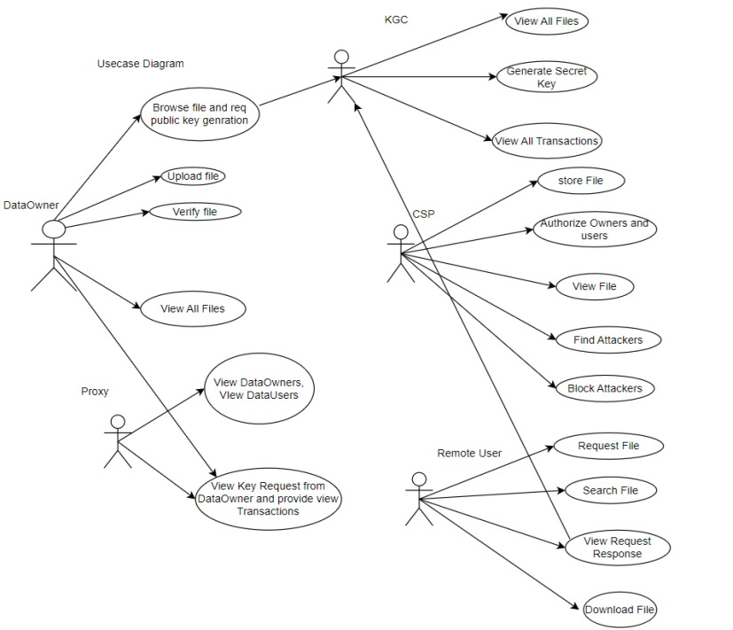
UML DIAGRAMS
1.Use case Diagram

Slide 14
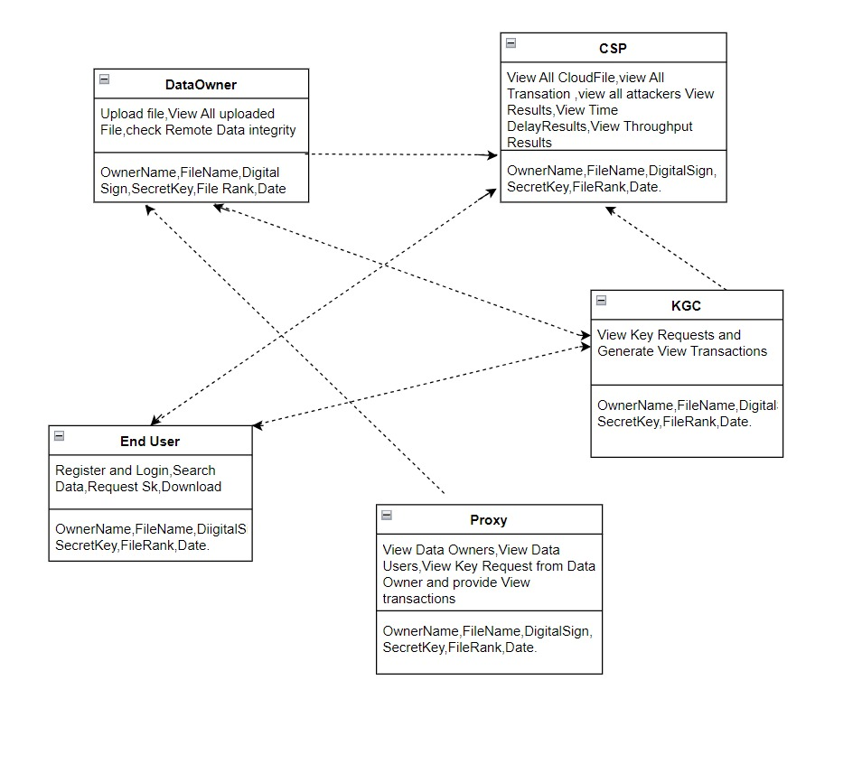
2.Class Diagram

Slide 15
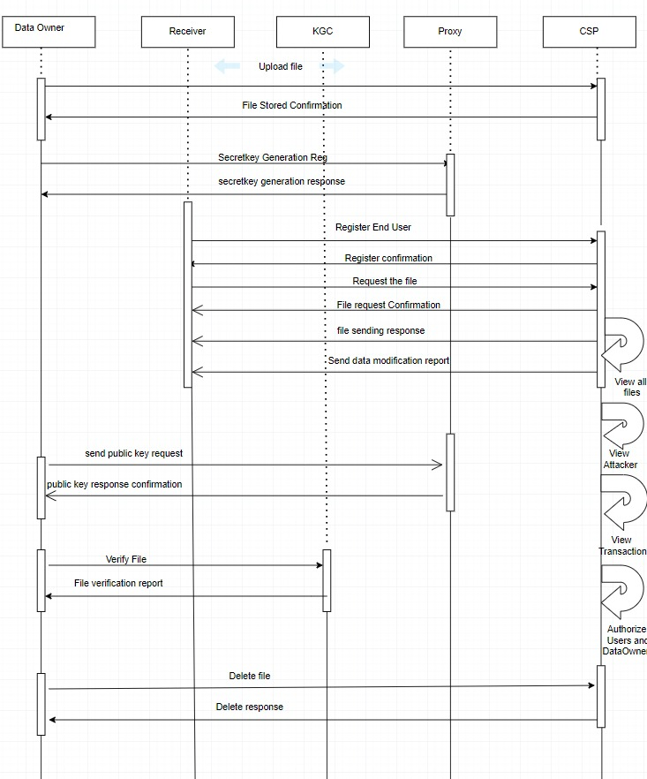
3.Sequence Diagram

Slide 16
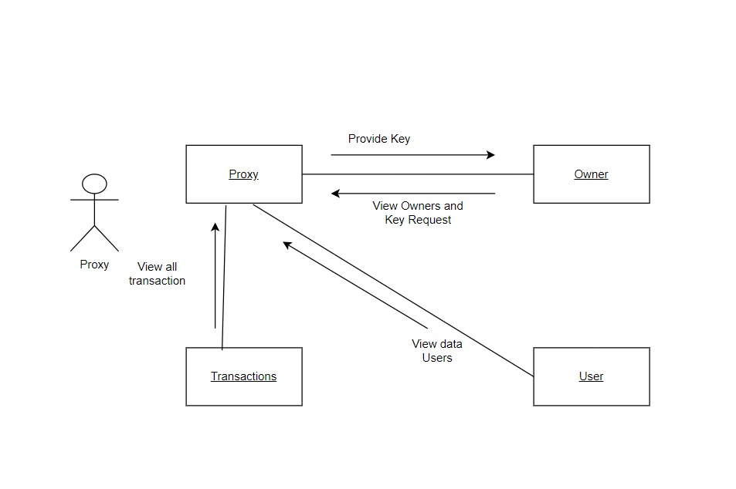
4.Collaboration Diagram
2
1
3
4

Slide 17
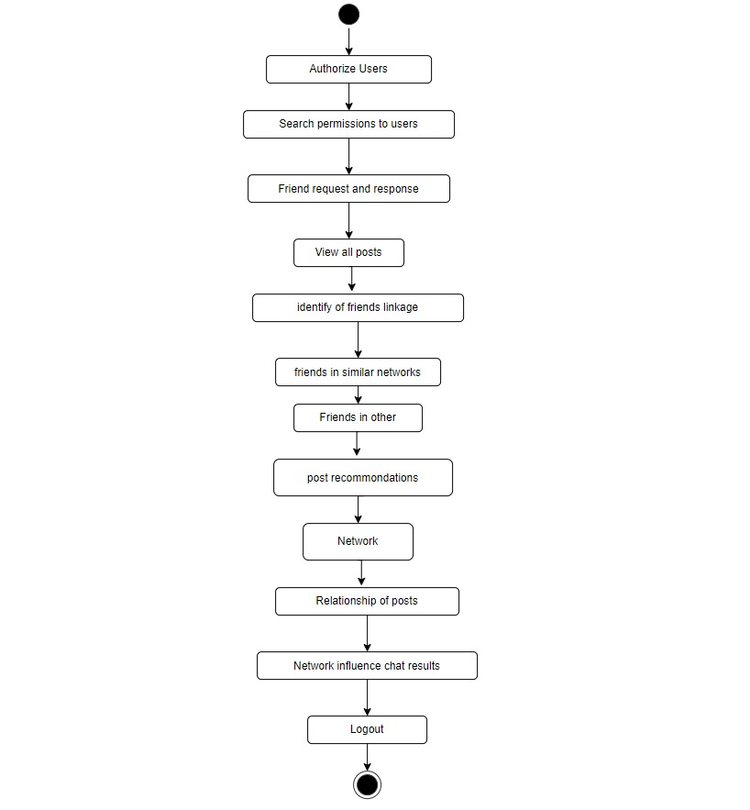
5.Activity Diagram for Admin

Slide 18
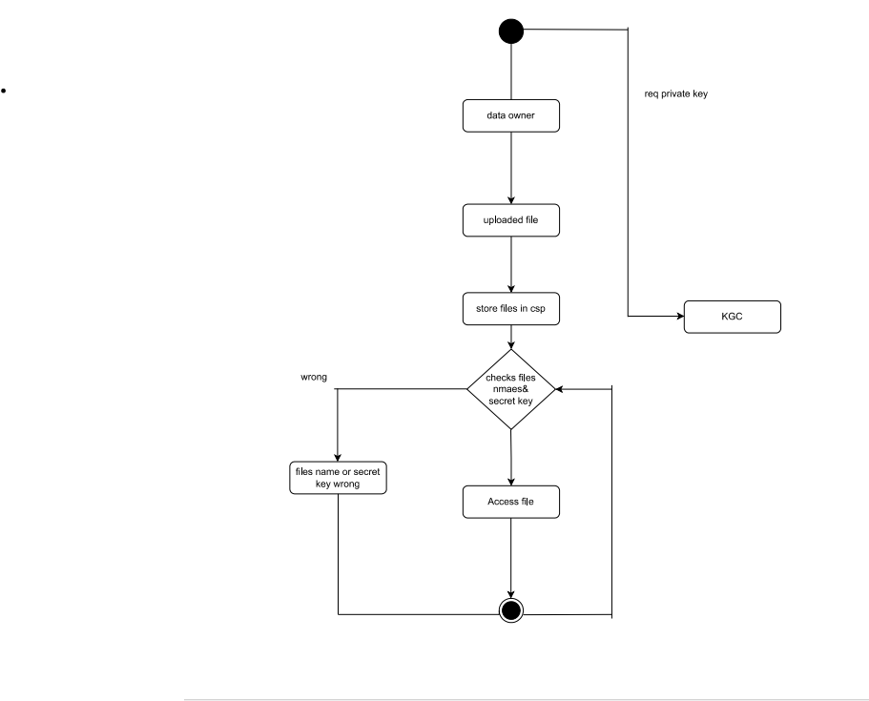
7.STATE DIAGRAM

Slide 19
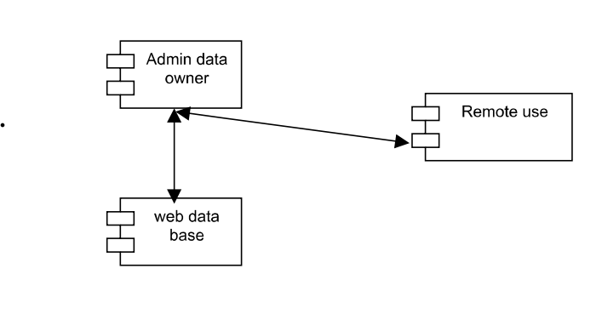
6.Component Diagram

Slide 20
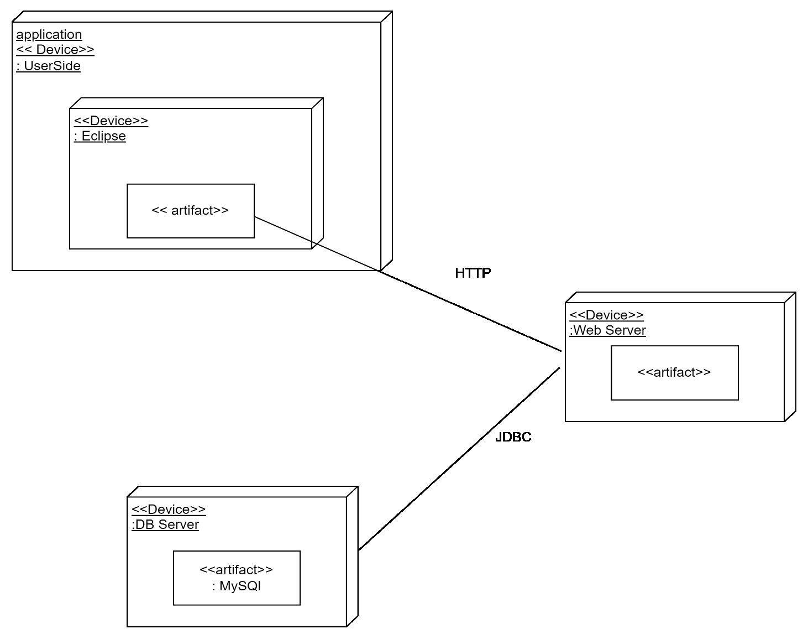
8.DEPLOYMENT DIAGRAM

Slide 21
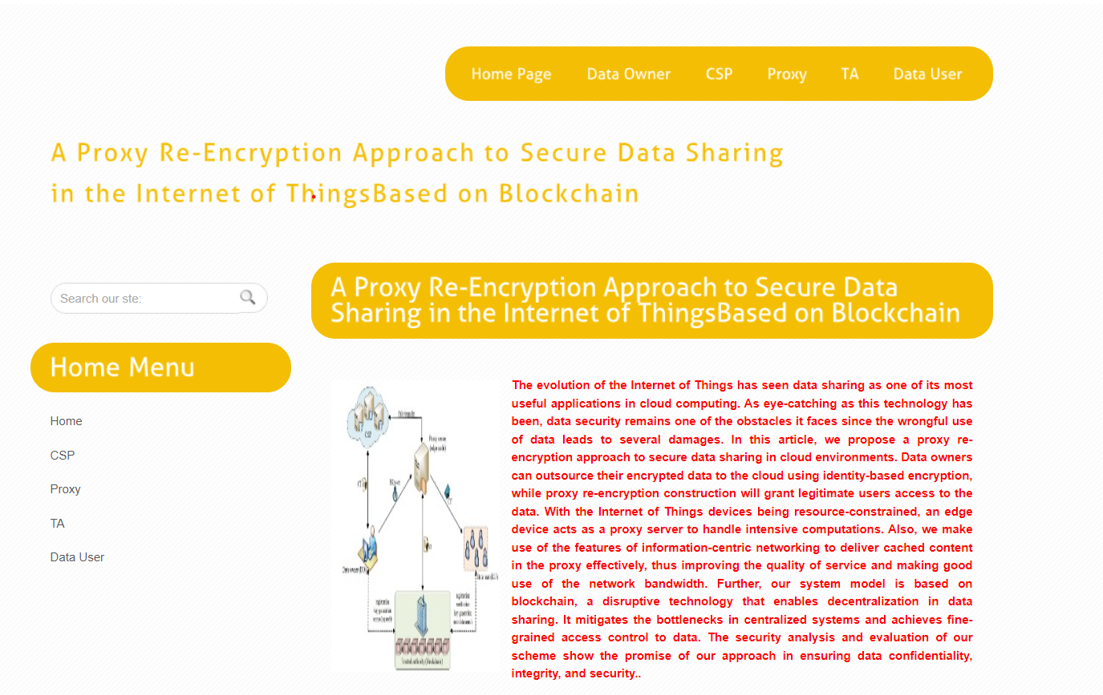
SCREENSHOTS
1)HOME PAGE:

Slide 22
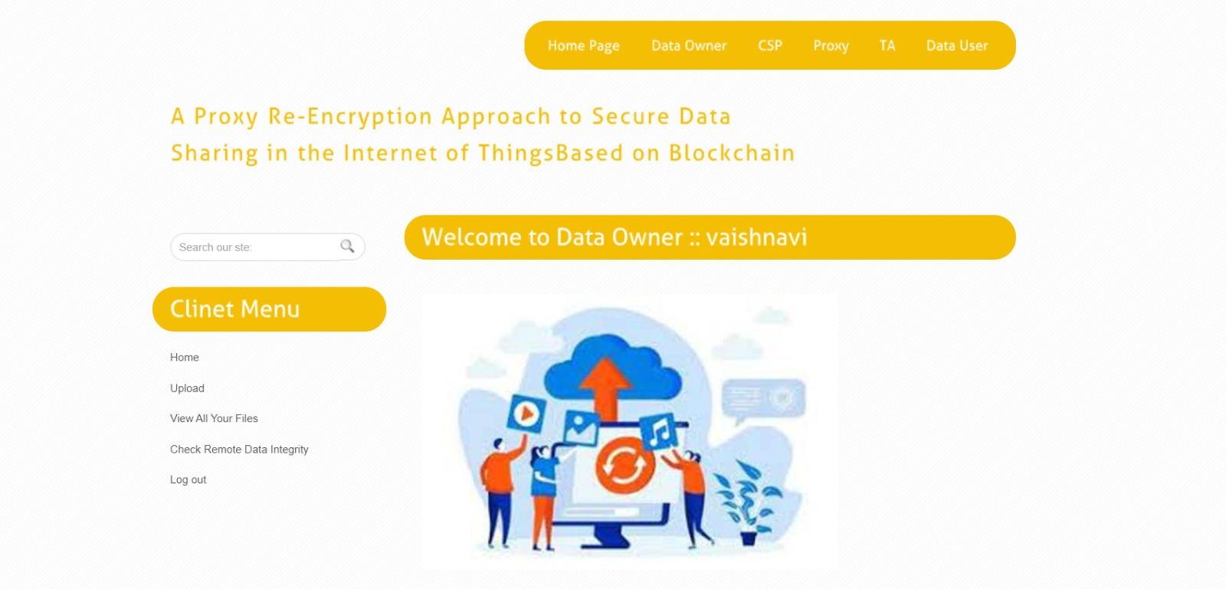
2)Owner page:

Slide 23
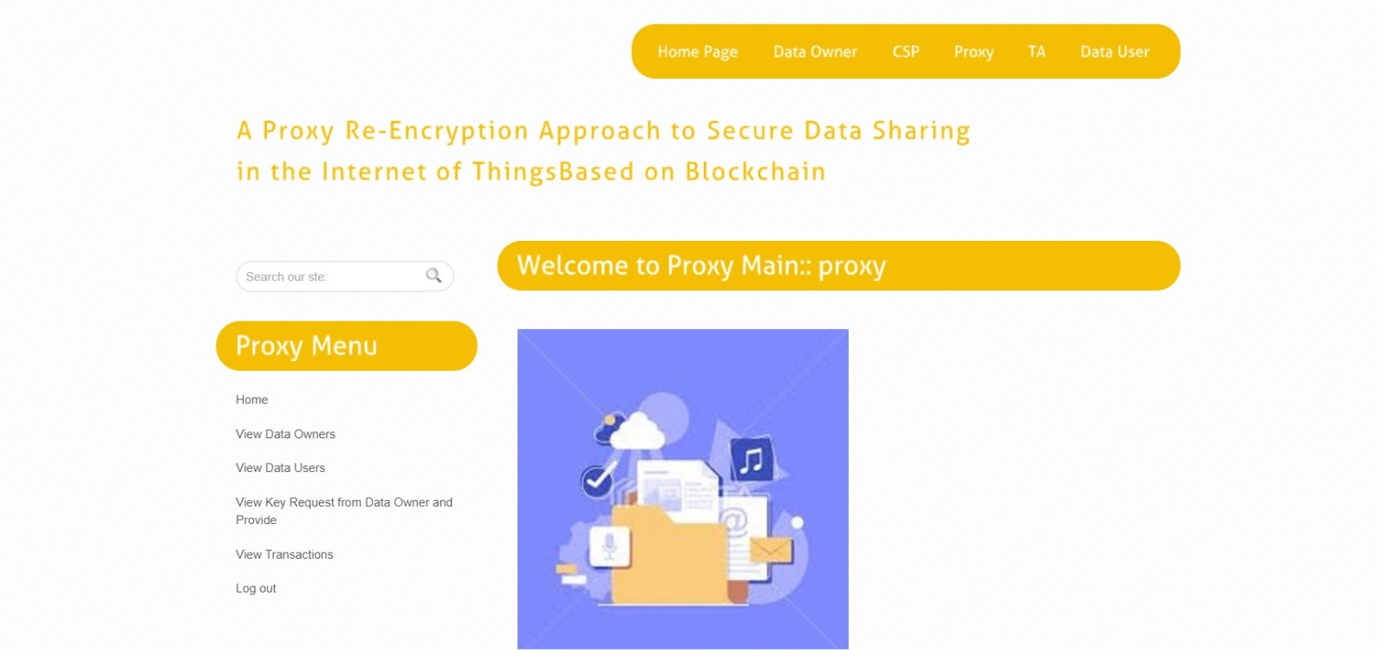
4)Proxy page:

Slide 24
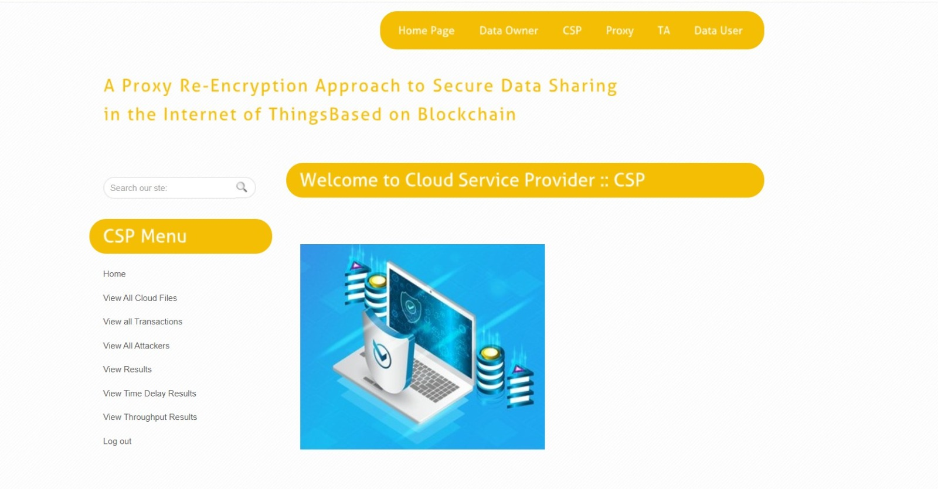
5)Cloud server page:

Slide 25
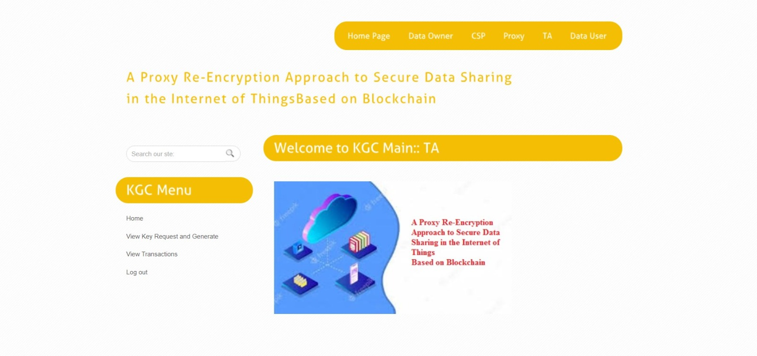
6)Trust authority page:

Slide 26
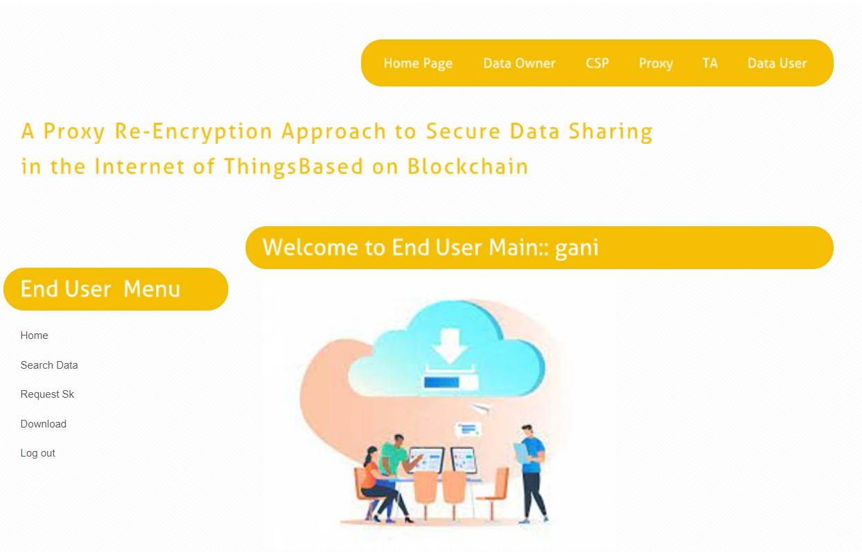
7)User page

Slide 27
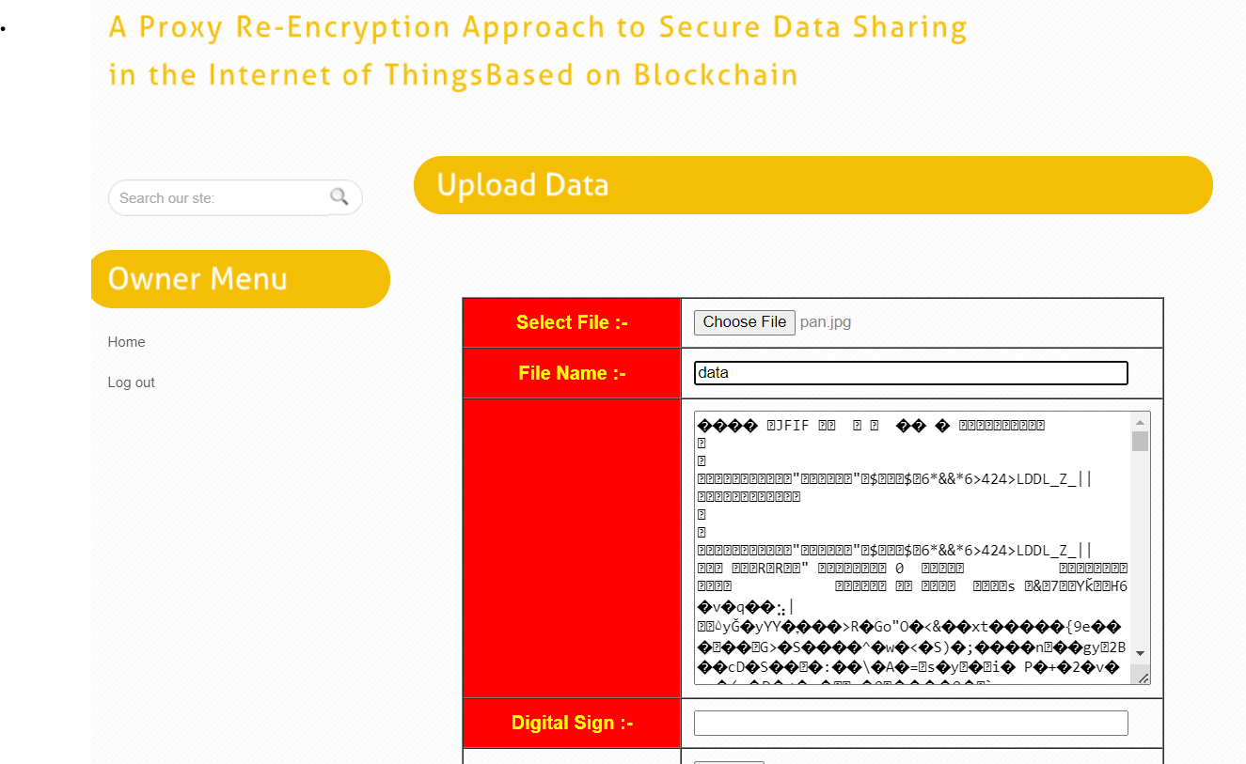
8)Upload Page:

Slide 28
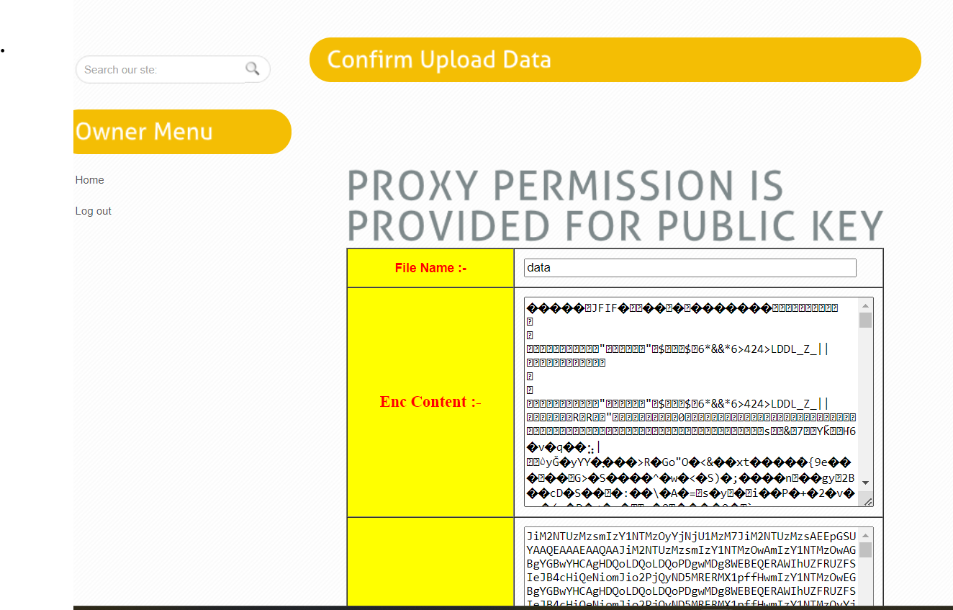
9)Uploaded Data

Slide 29
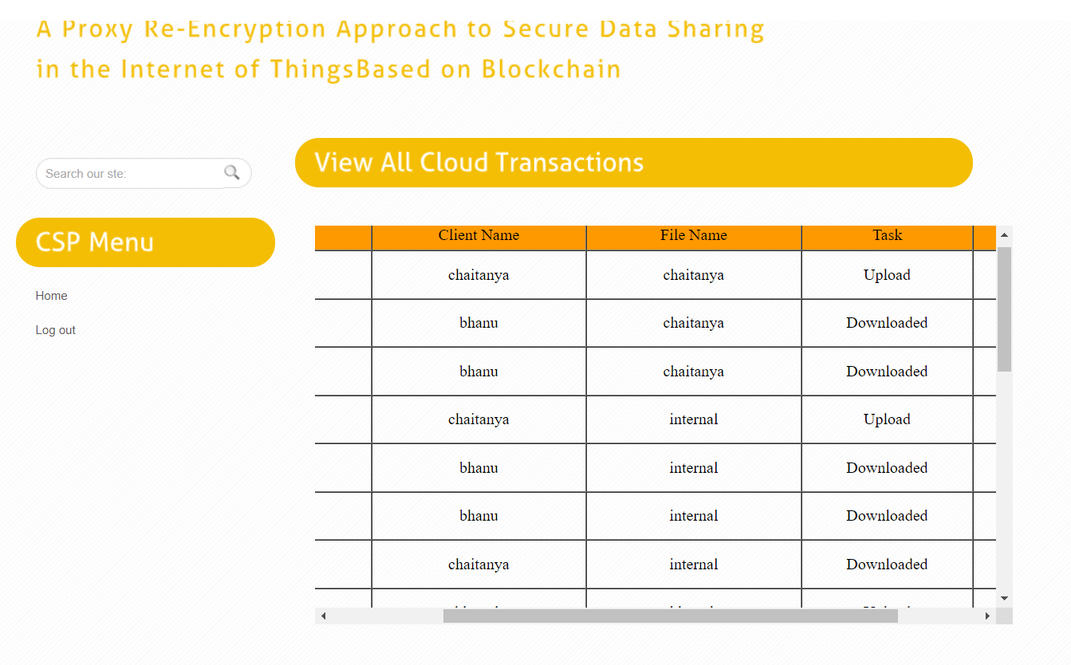
10)Cload Transzction

Slide 30
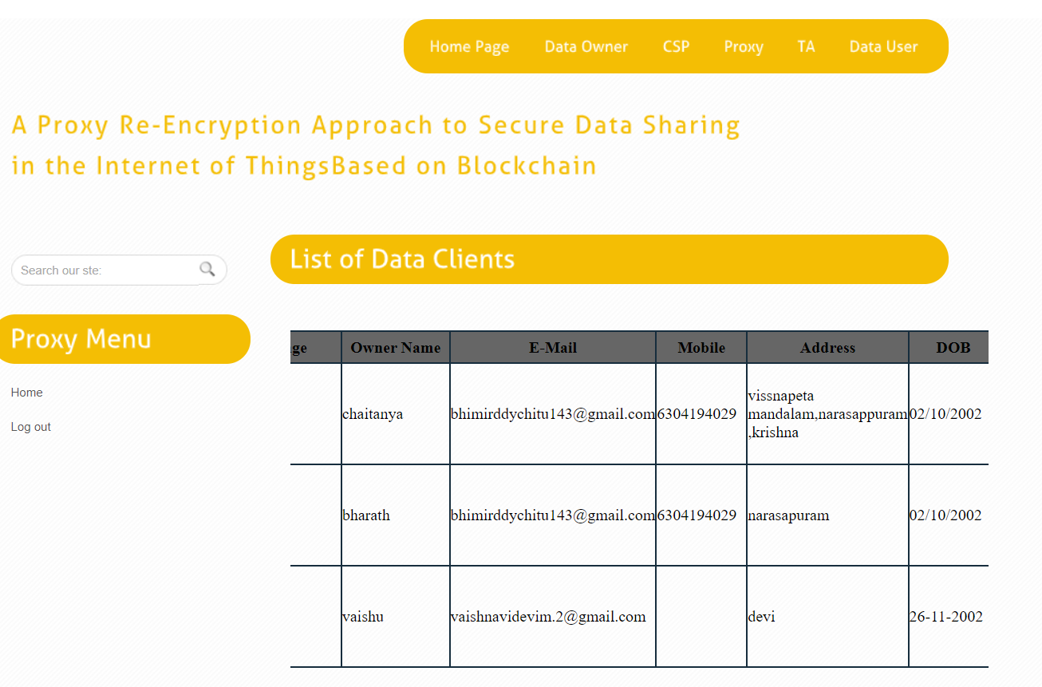
11)List of Data Clients Page:

Slide 31
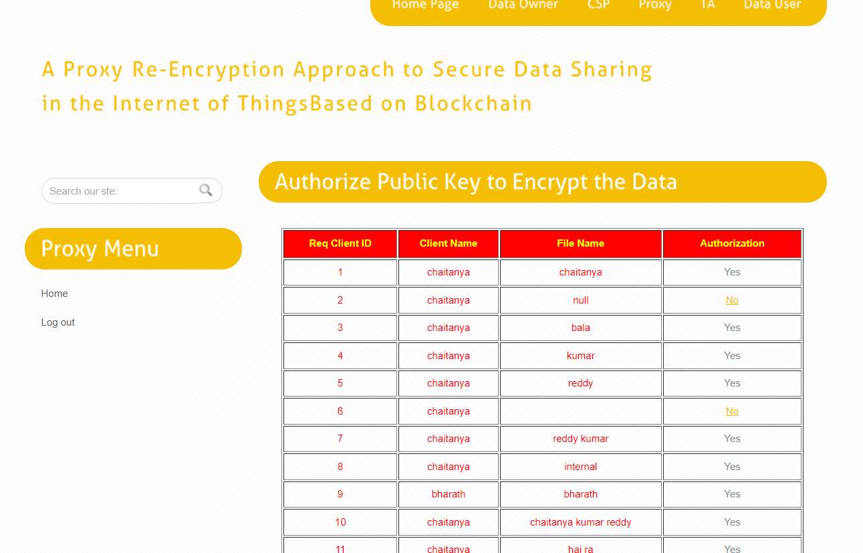
12)Key To Encrypt Data Page:

Slide 32
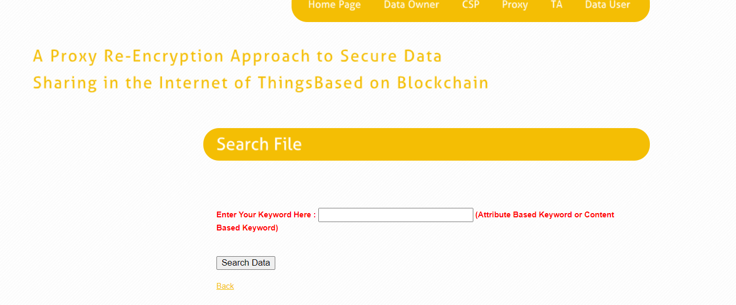
13)Search file page:

Slide 33
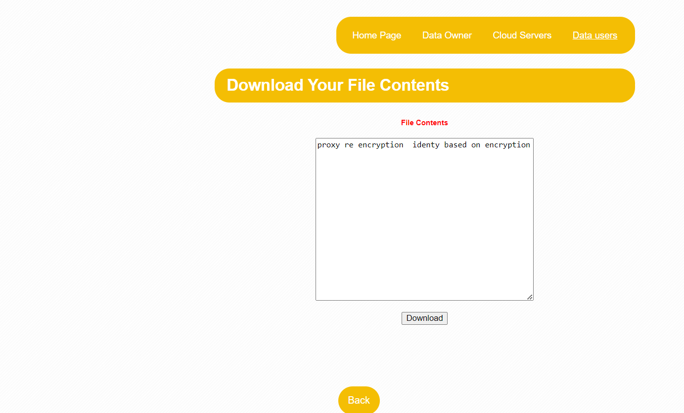
14)Download Your File Contents

Slide 34
CONCLUSION
The identity-based proxy re-encryption (PRE) data-sharing scheme in a cloud computing environment. This scheme allows data owners to store encrypted data in the cloud and share it efficiently with legitimate users using the identity-based PRE technique. Due to the resource constraints of IoT devices, an edge device acts as a proxy to handle intensive computations. Additionally, the scheme incorporates information-centric networking (ICN) features to deliver cached content effectively, improving service quality and optimizing network bandwidth usage.

Slide 35
REFERENCES
A. Al-Fuqaha, M. Guizani, M. Mohammadi, M. Aledhari, and M. Ayyash, “Internet of Things: A survey on enabling technologies, protocols, and applications,” IEEE Commun. Surveys Tut., vol. 17, no. 4, pp. 2347–2376, Oct./Dec. 2015.
M. Blaze, G. Bleumer, and M. Strauss, “Divertible protocols and atomic proxy cryptography,” in Proc. Int. Conf. Theory Appl. Cryptographic Techn., Springer, May 1998, pp. 127–144.
[A. Shamir, “Identity-based cryptosystems and signature schemes,” in Proc. Workshop Theory Appl. Cryptographic Techn., Springer, Aug. 1984, pp. 47–53.

Slide 36
THANK YOU

